Slide 1
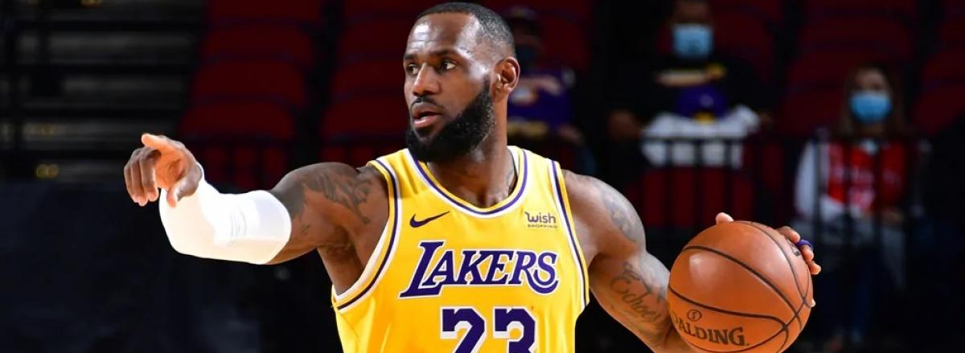
Rescheduling the NBA regular season via Integer Programming
Juan José Miranda Bront and Nicolás García Aramoun
Universidad Torcuato Di Tella, Argentina

Slide 2



The multiple challenges coming from the COVID19 Pandemic
Health
Challenges in multiple fronts
COVID19
Economic
Unexpected in almost all contexts.
Organization responded having little and imprecise information.
Safety measures, lockdowns and responses varied across countries.
Notes:
Explicar tours para aprovechar las distancias de Argentina
Mencionar que el cambio de la temporada 2017-18 es por muchos partidos

Slide 3
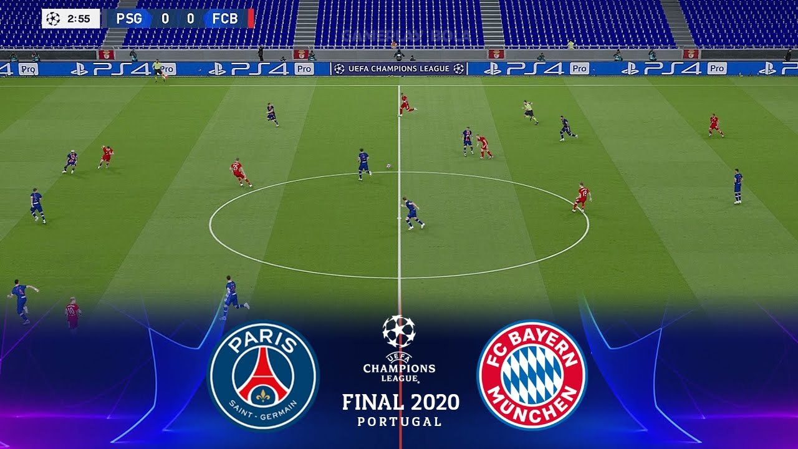

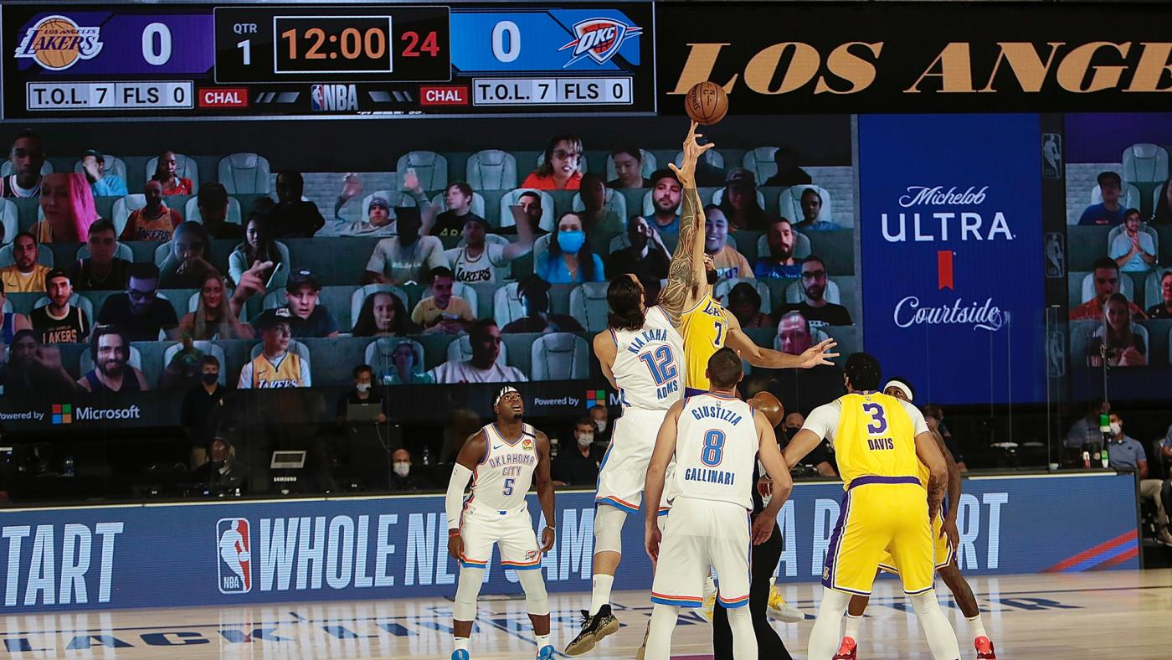
Impact in sport leagues around the world
UEFA Champions
League Final
(2020)
NBA Bubble (2019 - 2020)
Documentary centered on the NBA
Notes:
Explicar tours para aprovechar las distancias de Argentina
Mencionar que el cambio de la temporada 2017-18 es por muchos partidos

Slide 4
Rescheduling matches pre and post COVID
Pre-COVID
COVID
34%
Probability of a match being suspended in the NBA 2020-21 season, given than the previous match was suspended
Suspended matches are rare
Suspensions are usually not related to each other
Suspended matches are more common due to the health situation
If multiple players become sick, consecutive games might be suspended
Notes:
Explicar tours para aprovechar las distancias de Argentina
Mencionar que el cambio de la temporada 2017-18 es por muchos partidos

Slide 5



Rescheduling in sports
Two types of responses
Proactive
Reactive
Literature
Yi et al (EJOR, 2020) present proactive and reactive strategies for time-constrained schedules
Practice
Leagues like NBA, NHL and MLB have rescheduled games, but haven’t disclosed their methodological approach
Rescheduling necessities
Disruption Management
Techniques to systematically deal with unexpected events affecting the planned operations. Rescheduling strategies appear in other contexts, such as production, logistics, transportation (vehicles / railways), etc.
Notes:
Explicar tours para aprovechar las distancias de Argentina
Mencionar que el cambio de la temporada 2017-18 es por muchos partidos

Slide 6

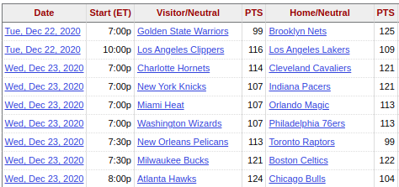
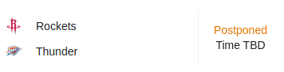
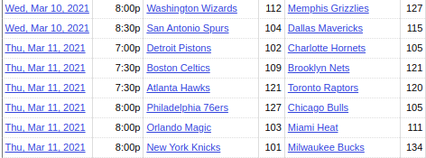
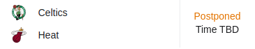

The 2020 - 2021 NBA Season
The NBA applied the following contingency actions during the season:
Allow 10-day contracts for free agents to replace players entering COVID19 protocols
Proactive scheduling strategy:
Schedule only the first half of the season (All-Star Game);
Postpone games if a teams has insufficient players to the second half;
Generate a schedule for the second half + suspended games
Ad-hoc reschedule for games suspended during the second half.
72
Games per team
31
Suspended games
3%
Games suspended
Notes:
Explicar tours para aprovechar las distancias de Argentina
Mencionar que el cambio de la temporada 2017-18 es por muchos partidos

Slide 7
Our approach: a reactive strategy
Definition
Each game in the executed timetable that is played before or after its scheduled round is considered a disruption. In our setup, each suspended game will therefore translate into a disruption that needs to be rescheduled in the remaining of the season schedule
Research Question
Can we systematically generate an adjusted fixture by rescheduling postponed games within the planned schedule?
Approach: a reactive strategy
Consider as input the planned schedule for the entire season.
Insert the disrupted matches onto the existing schedule, maintaining the original scheduled dates for non-disrupted matches
We build a linear optimization model to find the best possible date for each disruption and, if we can’t, we reschedule it after the end of the schedule’s original date
Notes:
Explicar tours para aprovechar las distancias de Argentina
Mencionar que el cambio de la temporada 2017-18 es por muchos partidos

Slide 8



Candidate dates for each disruption
A round t must follow these conditions
1
t occurs after the date in the original schedule
2
There are no planned games for the teams involved in the disruption on date t
3
There are no scheduling rules violations if the corresponding match is scheduled on t
At most one game between consecutive non-disrupted matches.
Limit the number of matches in 7-day periods (i.e., minimum rest conditions)
4
Both teams travel a reasonable distance if the corresponding match is scheduled on t
Notes:
Explicar tours para aprovechar las distancias de Argentina
Mencionar que el cambio de la temporada 2017-18 es por muchos partidos

Slide 9






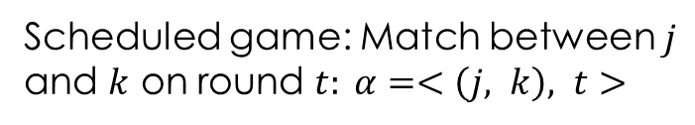
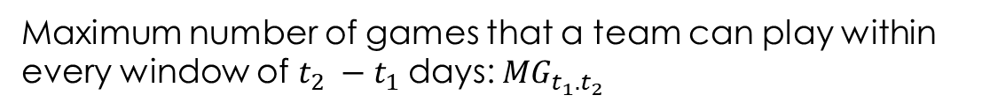
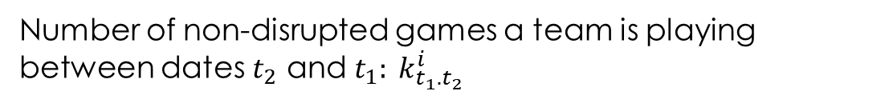
Notation and Definitions
General
Schedule Rules
Decision variables
x_{𝛂t} = 1 iff disrupted game 𝛂 is rescheduled into round t
Notes:
Mencionar que fácilmente se puede adaptar a otras situaciones (single round robin)

Slide 10
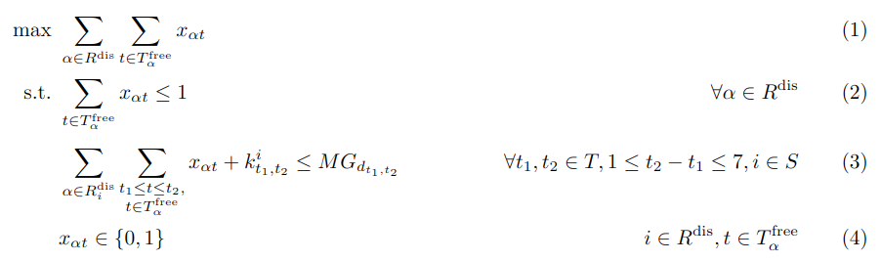
Mathematical Model (MaxG)
Maximize # rescheduled games
Games are rescheduled at most once
Satisfy maximum number of games in [t₁, t₂]
Notes:
Mencionar que fácilmente se puede adaptar a otras situaciones (single round robin)

Slide 11



Alternative Model (MinD)
Minimize total day difference with the original schedule
Games with feasible dates are rescheduled
=
Satisfy maximum number of games in [t₁, t₂]
Notes:
Mencionar que fácilmente se puede adaptar a otras situaciones (single round robin)

Slide 12
Preliminary experiments
We consider the (final) NBA 2020 - 2021 regular season schedule
Recall, it was defined in two stages.
Result of a Proactive Strategy
Acts as a benchmark for our results (NBA exec).
Rescheduled dates for postponed games are not considered as part of the input schedule (except for some special configurations)
We consider the following metrics:
Classical from scheduling: distance, breaks.
New: # of day added and # of games played after the end of the season in the planned schedule.
Models and algorithms implemented in Python + CPLEX.

Slide 13
Rescheduling Strategies
In order to get a better understanding of the performance of our solution we try to replicate the rescheduling process for the suspended games of the 2020-21 NBA season
Rescheduling methodology
Monthly
Post All-Star
Dec
Jan
Feb
Mar
Apr
May
At the end of each month, we reschedule the disruptions that happened there.
We consider the rest of the sesason.
Dec-Jan-Feb
Mar
Apr
May
Wait until the All-Star break to reschedule first set of matches, then follow the monthly approach
Monthly* and Post All Star*
Discard the distance constraints and use the NBA’s reschedules if they happened within the month of the original game

Slide 14
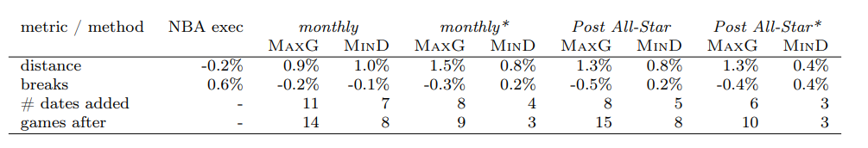
Main Results
Number of additional days needed after the end of the season
A
B
C
Number of games scheduled after the end of the season
Key Takeouts
All differences are small (around 1%)
There is usually an improvement in breaks and distance worsening
The distance constraint has effects on the additional number of dates needed
A
B
C

Slide 15
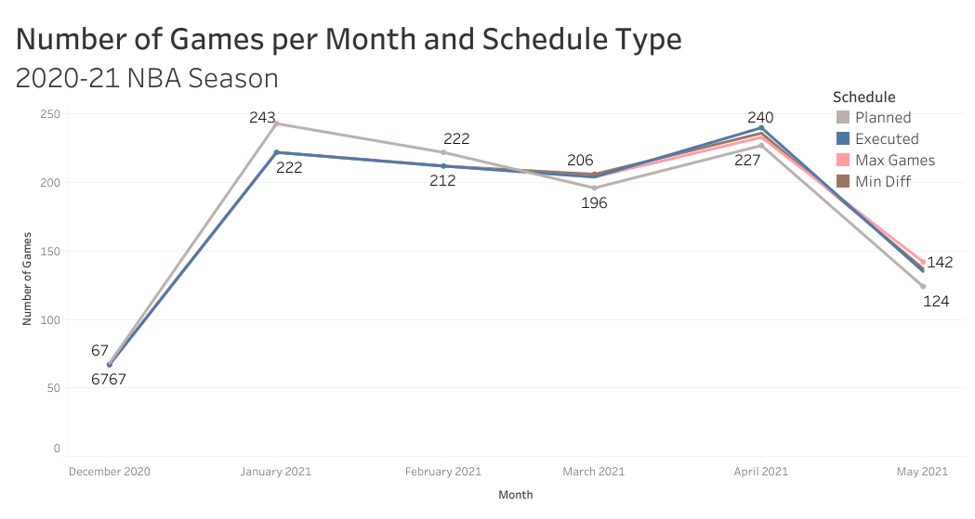
Game Calendar
A
B
Number of games per month is similar for all strategies
It appears the NBA left a less concentrated second half to have a greater buffer
A
B

Slide 16
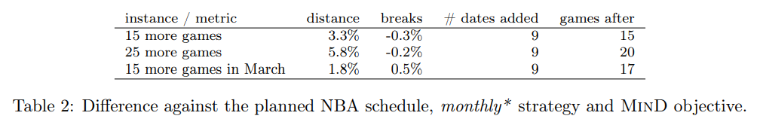
Further Disruption Scenarios
We consider instances stressing the the number and timing of the disruptions:
15 more games: ~50% increase in the problem size
25 more games: ~80% increase in the problem size
15 more March games: Similar to a second COVID wave
A
A
Effects on relevant KPIs is not negligible

Slide 17
Summary
We framed the problem of rescheduling in time-relaxed tournaments
We evaluate different rescheduling strategies building on MIP models
Initial results show we are obtaining similar results than the ones produced by the NBA
More stressed disrupted scenarios have a considerable impact on relevant KPIs
Next steps
Extend to other time-relaxed tournaments.
How to manage Play-in, Playoffs?
Study of scheduling constraints in more detail (quality, impact, etc) more deeply.

